Slide 1

Song Energy Classifier.
By: Divyam Patel , Vineet Kotian , Rohan Swain
Notes:
Good evening everyone my name is Vineet and I am here with my teammates Divyam and Rohan to present our project on Song Energy Classifiers.

Slide 2

CONTENTS
PROBLEM STATEMENT
DESCRIPTION OF DATASET
RELATED WORK
APPROACH
TRAINING AND TESTING DATA
STEP 1 : DATA CLEANING AND REPLACEMENT OF VALUES
STEP 2 : DATA ANALYSIS AND VISULIZATION
STEP 3 : DATA PREPROCESSING
STEP 4 : PREDICTION USING CLASSIFICATION MODELS
RESULTS
ABLATION STUDY
Notes:
We will dive into the topic in a systematic way to understand every detail.

Slide 3
PROBLEM STATEMENT
Overabundance of songs across genres makes it challenging for users to curate playlists based on desired energy levels.
How often have you skipped a song because it didn't resonate with your current energy levels
Do specific audio features in songs influence the energy levels?
Can we predict energetic songs from others with a certain level of certainty?
Notes:
Have you ever had this moment where you really enjoy the songs that you are listening to and the next track that plays doesnt match the vibe and just breaks the flow? This is why the use of song classification on streaming platforms like spotify is really important. Currently they use features like genre artists etc to predict similar songs and there is a gap in this segment that can help make predictions and recommendations much better. This is where the song energy classifier comes in. It could be used as an additional filter in collaboration with existing approaches to get really good results.
The most important question we must ask ourselves is what attributes of the songs influence the energy levels? Once we find these features we use them to achieve really good results.

Slide 4
DESCRIPTION OF DATASET
30,000+ songs and their features.
Energy measure of intensity and activity. Energetic tracks feel fast, loud, and noisy.
Loudness is the quality of a sound that is the primary psychological correlate of physical strength (amplitude). Values typical range between -60 and 0 dB.
Speechiness detects the presence of spoken words in a track. The more exclusively speech-like the recording (e.g., talk show, audiobook, poetry), the closer to 1.0 the attribute value.
Acousticness: Value describes how acoustic a song is. A score of 1.0 means the song is most likely to be an acoustic one.
Tempo is the speed or pace of a given piece and derives directly from the average beat duration.
Notes:
For our project we used an extensive dataset from kaggle that has more than 30 thousand songs and their features.
When songs are loud fast and noisy they could be a measure of intensity of energy. like loudness is how loud a song is based on decibel levels
speechiness determines the presence of spoken words in the track
acousticness determines how acoustic a song is
the tempo is a really good measure of song energy too as it determines the pace of the song

Slide 5
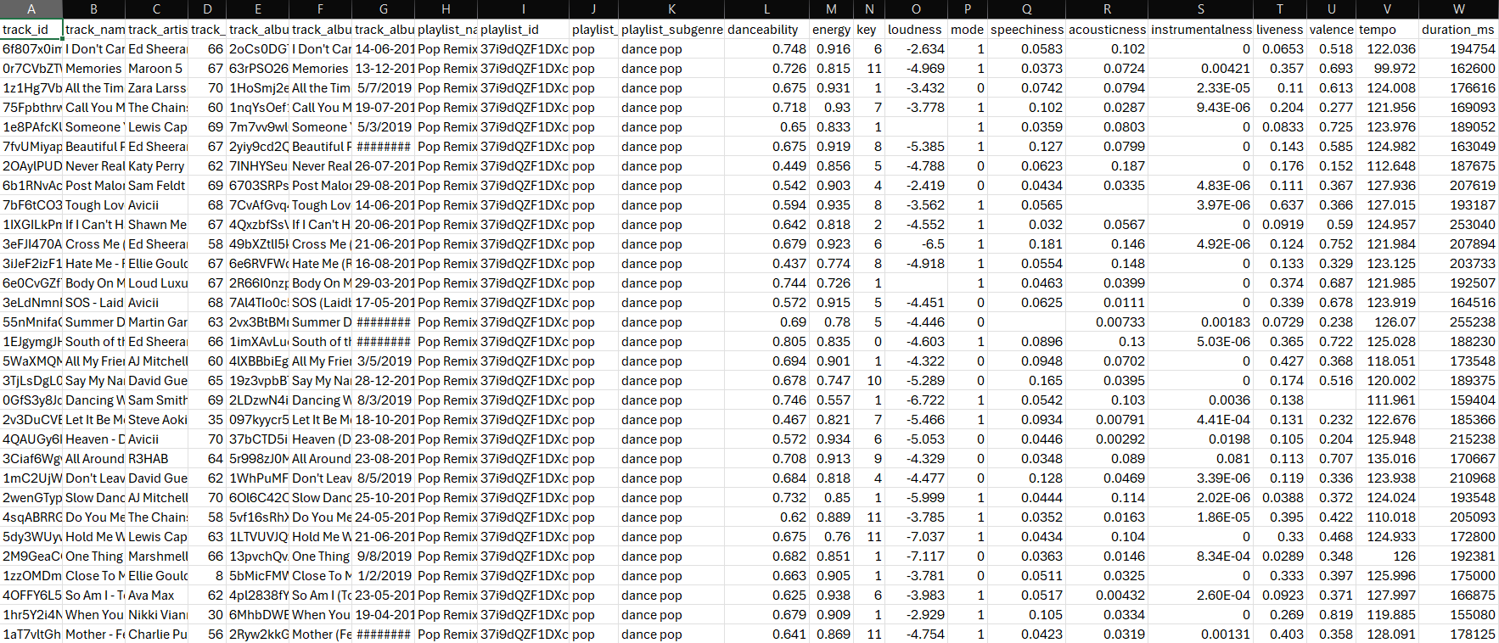
DATASET
Notes:
We focused on features like tempo, loudness, speechiness, valence, and acousticness because they showed a strong correlation with the target variable (energy) during our analysis. The excluded features either had low relevance, added noise, or did not significantly improve the model's performance.

Slide 6
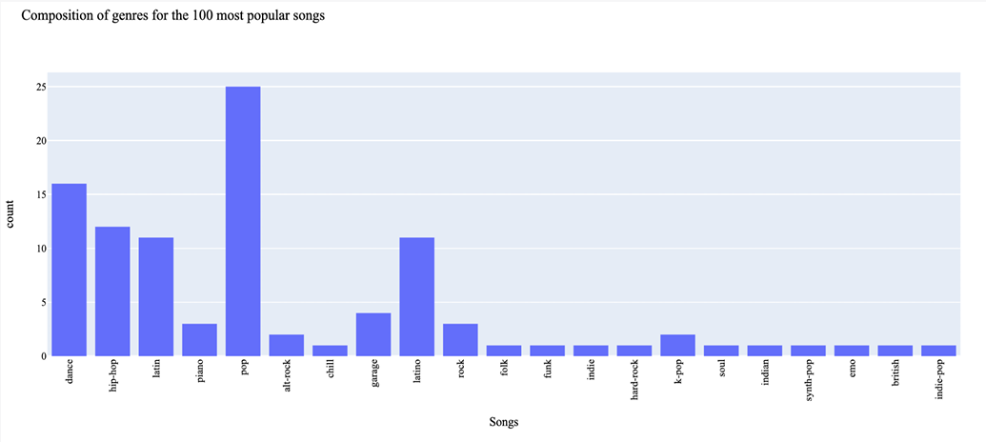
RELATED WORK
Machine Learning and Music: Predicting the level of energy conveyed by a soundtrack - Roberto Colangelo.
Notes:
In the last decade Spotify has emerged as a prominent music streaming platform,providing a comprehensive dataset for research on music information retrieval (MIR). Thisdataset has been the subject of numerous studies, aimed at extracting crucial insights anddeveloping innovative technological tools that could revolutionize user experience and transformthe music industry. In recent years, machine learning has gained significant traction as anapproach to music analysis and researchers have employed a diverse range of machine learningtechniques, such as neural networks, decision trees, and regression models, to investigatedifferent facets of music. Notably, machine learning algorithms have been extensively used topredict audio features associated with the Spotify dataset and its music tracks but only a fewfocused on predicting the energy level of tracks.
A research paper has been published by Roberto Colangelo naming Machine Learning and Music: Predicting the level of energy conveyed by a soundtrack.
Where he has classified the songs based on the genres.

Slide 7
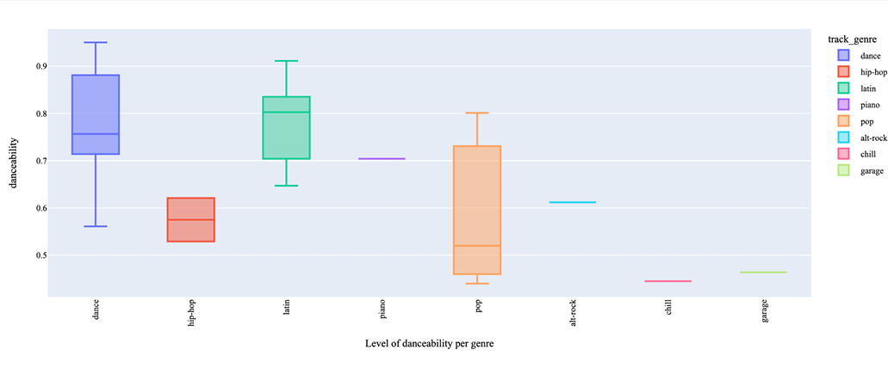
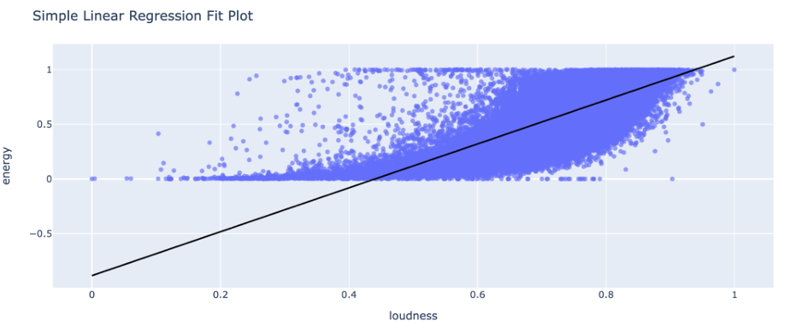
RELATED WORK
Notes:
He has taken similar dataset as ours and compared every feature to find the correlation between them and classifiy based on their genre.
He has used
Linear Models: like
Simple Linear Regression
Ridge and Lasso Regression
Tree-Based and Nonlinear Models: like
Decision Trees
Random Forest
Gradient Boosting
XGBoost
Neural Network-Based Models: Multilayer Perceptron (MLP)
Deep Neural Networks (DNN).
Whereas in our works we are using a limited number of features which truly affect the energy of the song and then classify songs based on our tradional methods like Linear Regressing, Random forest, SVM, Naïve bayes, and KNN.

Slide 8
EXISTING METHODS
Random Forest Regressor:
Combines multiple decision trees.
Trees trained on random subsets of data.
Advantage: Handles complex interactions; reduces overfitting.
Achieved an Rsquared of 0.863 and MAE of 0.071 on the dataset.
XGBoost Regressor:
Optimized version of Gradient Boosting.
Incorporates regularization to avoid overfitting.
Best performance: Rsquared of 0.878 and MAE of 0.067.
Highly efficient for large datasets with nonlinear relationships.
Notes:
Random Forest Regressor builds multiple decision trees, each trained on a random subset of the data. This method is robust, reduces overfitting, and captures complex feature interactions. In his study, Random Forest achieved an Rsquared value of 0.863 and a Mean Absolute Error (MAE) of 0.071.
On the other hand, XGBoost Regressor is an optimized gradient boosting method. It uses advanced techniques like regularization and gradient-based sampling to improve performance and efficiency. This method stood out, achieving the best results: an Rsquared value of 0.878 and an MAE of 0.067.
Together, these methods demonstrate the power of tree-based and ensemble approaches in predicting music energy levels with high accuracy."

Slide 9









APPROACH
STEP 1 :
STEP 2 :
DATA ANALYSIS
STEP 3 :
DATA PREPROCESSING
STEP 4 :
CLASSIFICATION USING MODELS
DATA CLEANING
Notes:
Our approach involved four major steps:
Data cleaning and handling missing values.
Data analysis and visualization to understand feature distributions and relationships.
Data preprocessing, where we normalized features using Min-Max scaling.
Finally, applying classification models to predict energy levels.”

Slide 10
TEST & TRAINING DATA
Notes:
This is our training and testing data split, 80% of the data we are using for training and rest 20% is used for testing.
We have also randomized the data to have a better generalization.

Slide 11
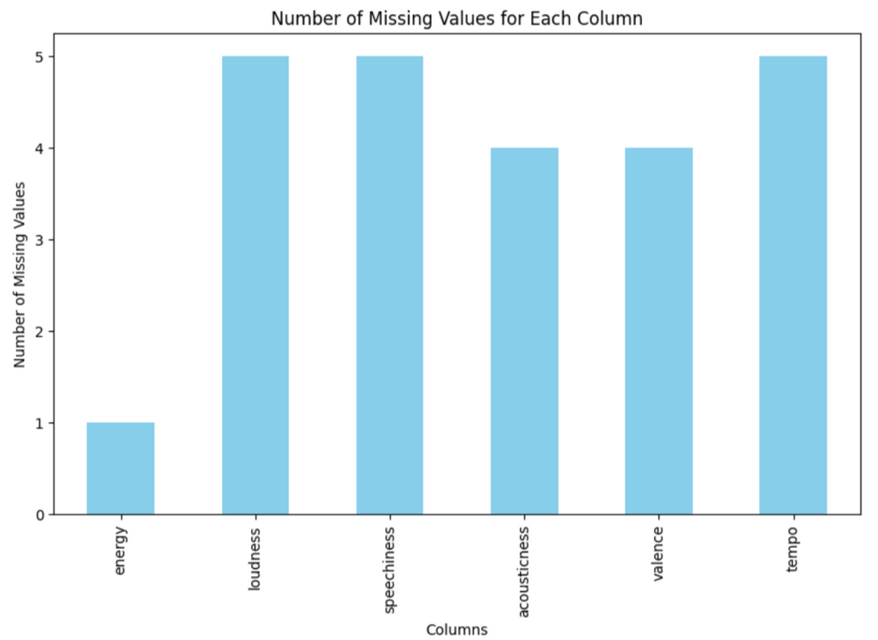
STEP 1 : DATA CLEANING
Representation of missing values in the data set.
Rows with missing values are removed.
Notes:
We identified rows with missing values and removed them since each song is unique and imputing values wouldn’t make sense. This ensured the dataset was complete and consistent for analysis.

Slide 12
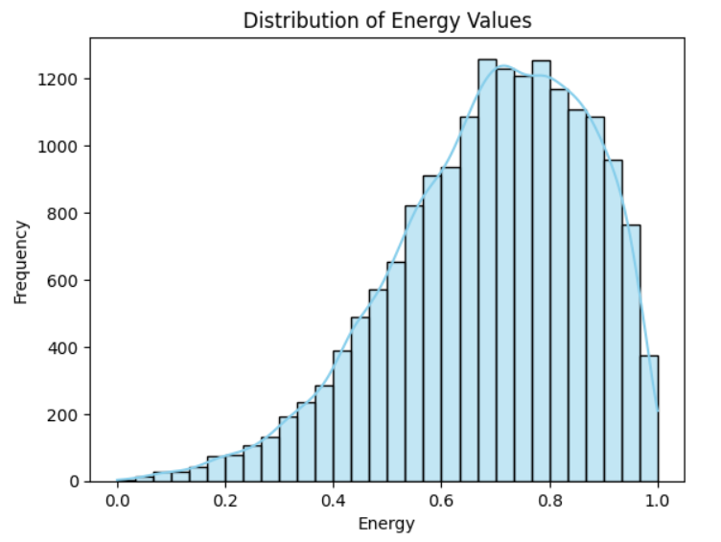
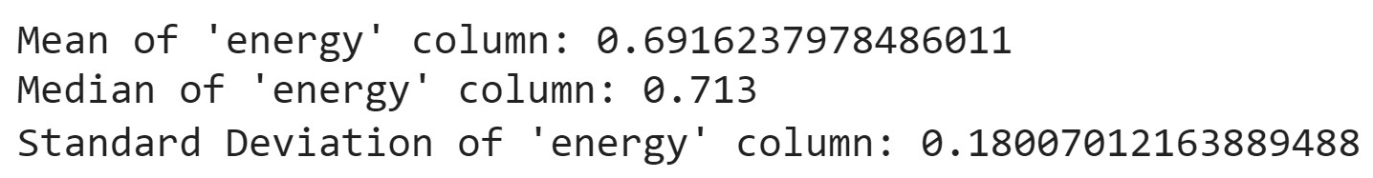
STEP 2 : ANALYSIS & VISUALIZATION
Notes:
“We then analyzed the data to understand feature distributions and correlations:
Features like tempo, speechness and loudness were found to significantly influence energy levels.
Visualization techniques like histograms helped us identify trends and patterns in the data.
These insights guided our preprocessing and modeling decisions.”
MEAN provides the average value of a feature, giving a central tendency of the dataset. It helps to understand where most of the data points are concentrated.
MEDIAN Identifies the central tendency like when the data has extreme values.
STANDARD DEVIATION measures the spread or variability of data around the mean. It helps determine whether a feature has consistent or widely varying values.
MEAN, MEDIAN and STANDARAD DEVIATION helps us in normalization.

Slide 13


STEP 3 : PREPROCESSING
The data is NORMALIZED using MIN-MAX SCALER
1
Notes:
Coming onto Preprocessing
It was crucial to ensure model performance.
We have used Min-Max scaling to normalize features like tempo and loudness to a range of [0, 1].
This prevented features with large ranges from dominating distance-based models like KNN, SVM”
You can see the equation for min max scaling,
Where:
X: is theOriginal feature value
Xmin ​: is the Minimum value in the feature
Similarly, Xmax ​:is the Maximum value in the feature
X′: is Scaled feature value which ranges between 0 and 1.

Slide 14




STEP 4 : CLASSIFICATION MODELS

Slide 15
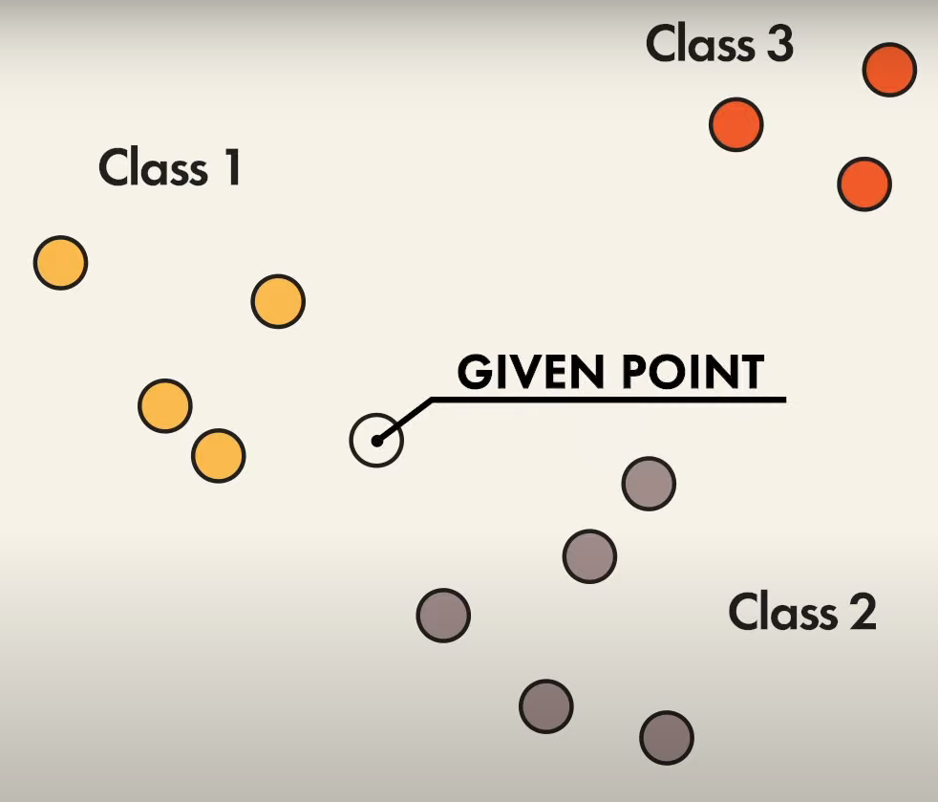
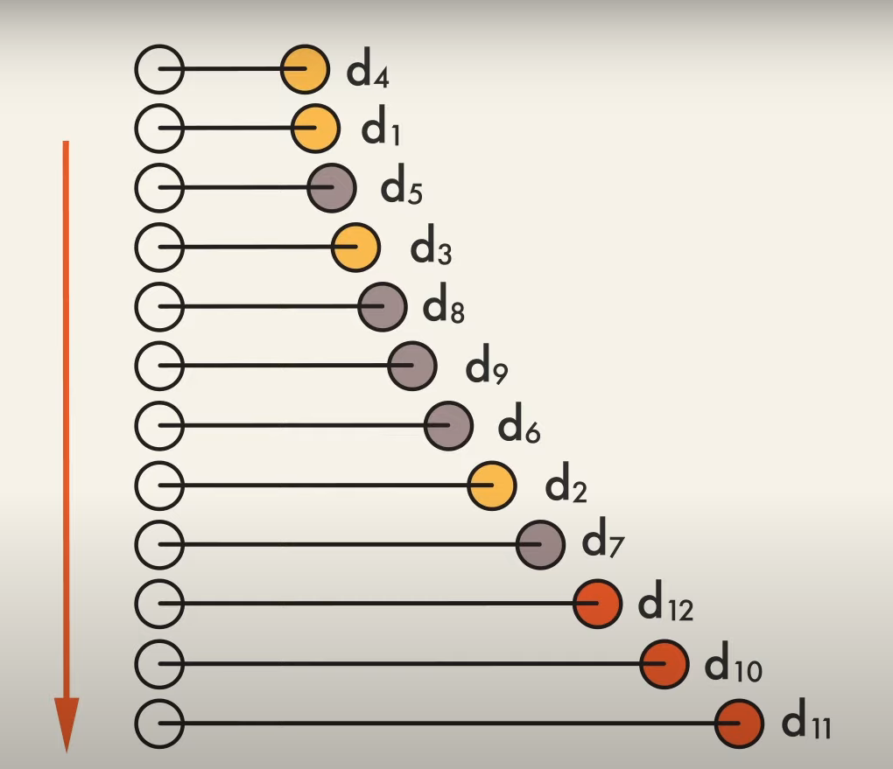
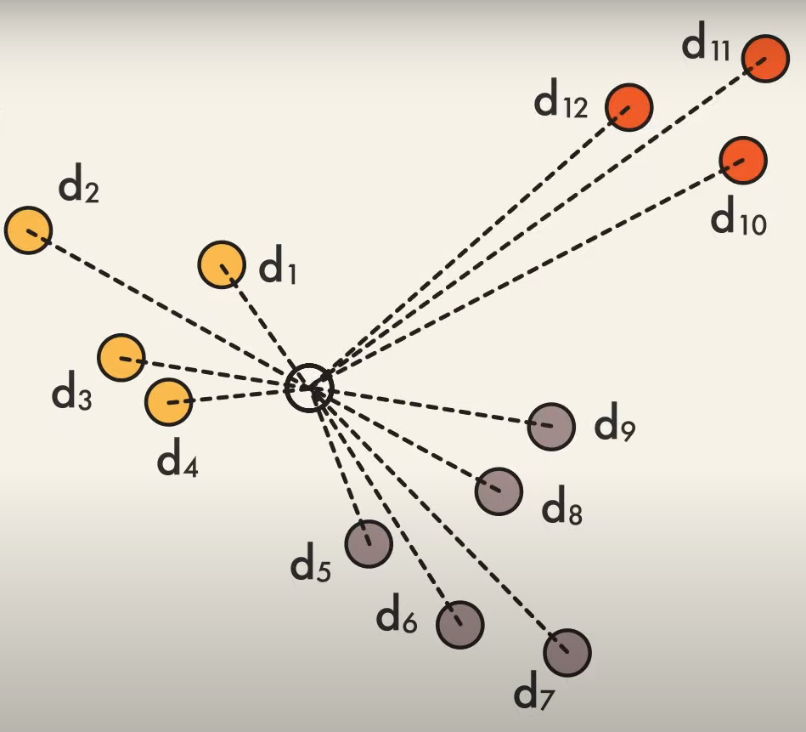
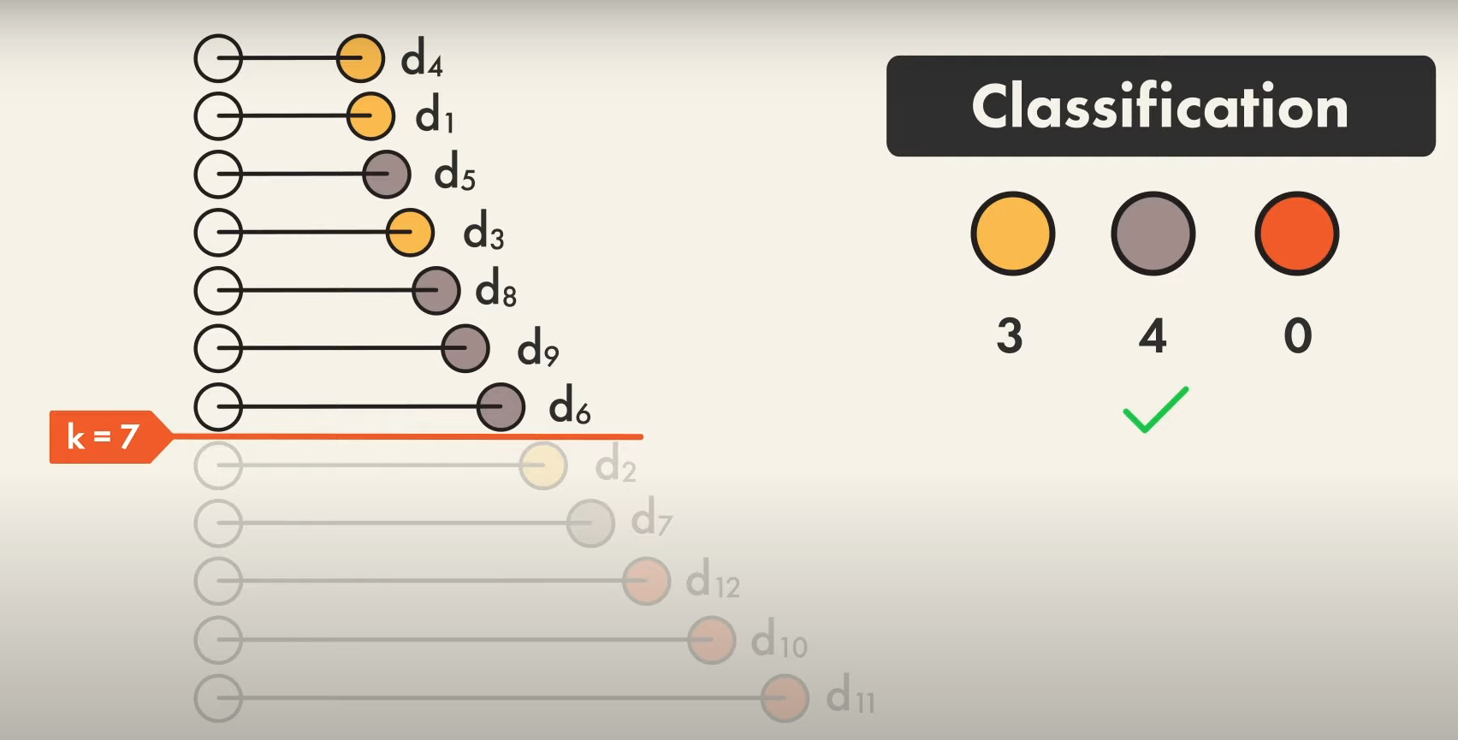
KNN (BEST MODEL)
STEP 2 :
STEP 1 :
STEP 3 :
Notes:
So now coming onto the KNN part it stands for (k-nearest neighbors algorithm). It is a simple, non-parametric, instance-based machine learning algorithm used for classification and regression tasks.
It makes predictions based on the similarity of data points in the feature space.
Let us see briefly see how KNN Works?
We can see our given point ane we want our point to place in one of the following classes.
Firstly the, KNN calculates the distance between our given point and all points in the training dataset.
then it selects the k closest points to our given point.
then the class with most number of points closer to our given point. Will be the class which our given point would fall into.

Slide 16
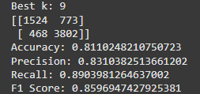
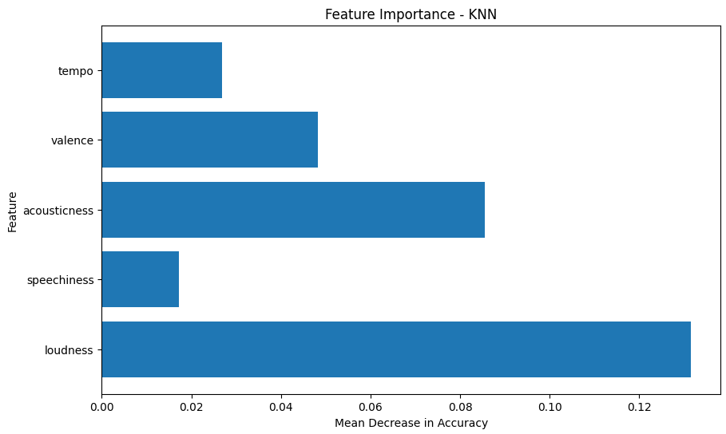
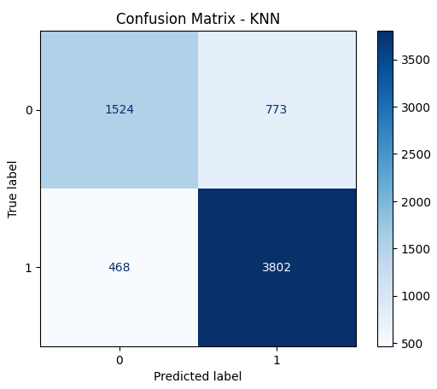
KNN (BEST MODEL)
OUTPUTS :
Notes:
You maybe wondering what K and F1 score means
So K is the number of neighbours and,
The F1 Score is the harmonic mean of precision and recall. It is useful when the dataset is imbalanced, as it considers both positives and false negatives for overall model performance.

Slide 17
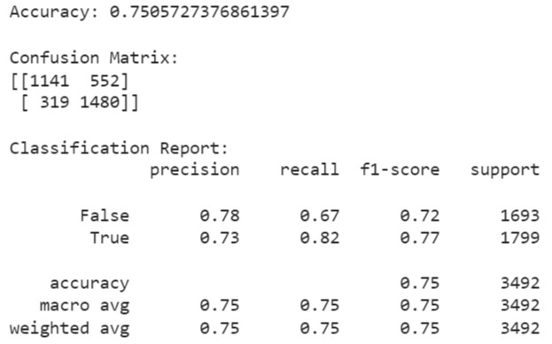
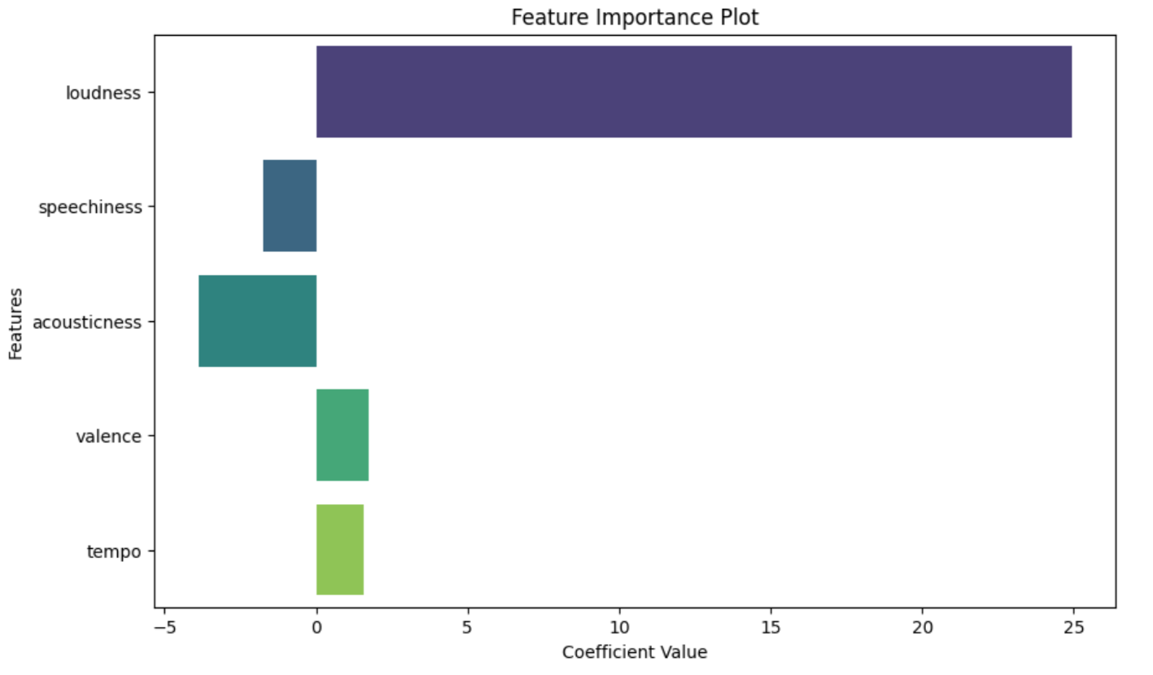
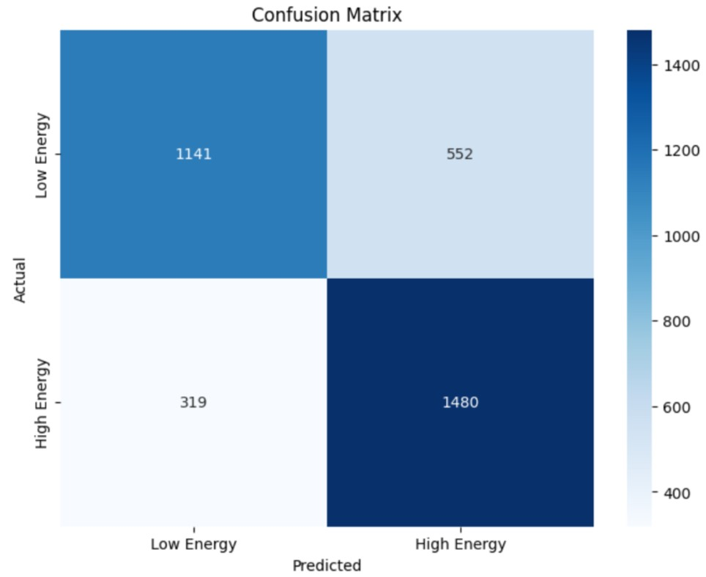
RESULTS
LINEAR REGRESSION
Notes:
A interesting thing we could see in this is the negative coefficient values for some feature this is because the negative values represent the direction of the relationship between the feature and the target variable, which here is energy.
So A positive value means the feature has a direct relationship with the target variable. For example ,higher the tempo higher the energy
A negative value means the feature has an inverse relationship with the target variable. For example , higher accousticness leads to lower energy.

Slide 18
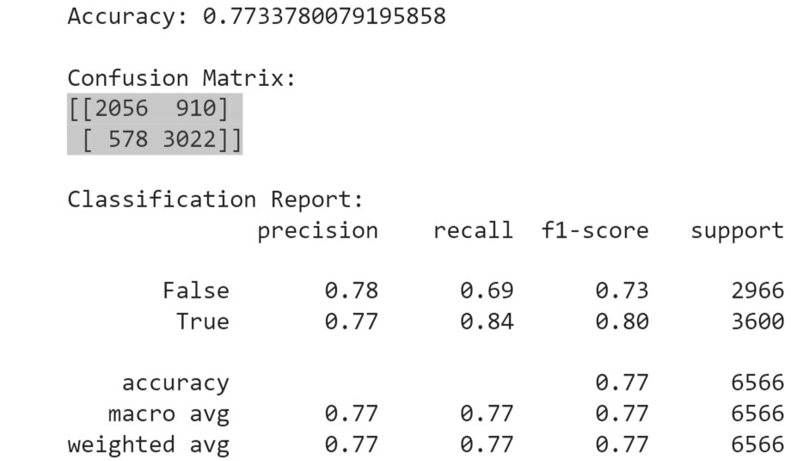
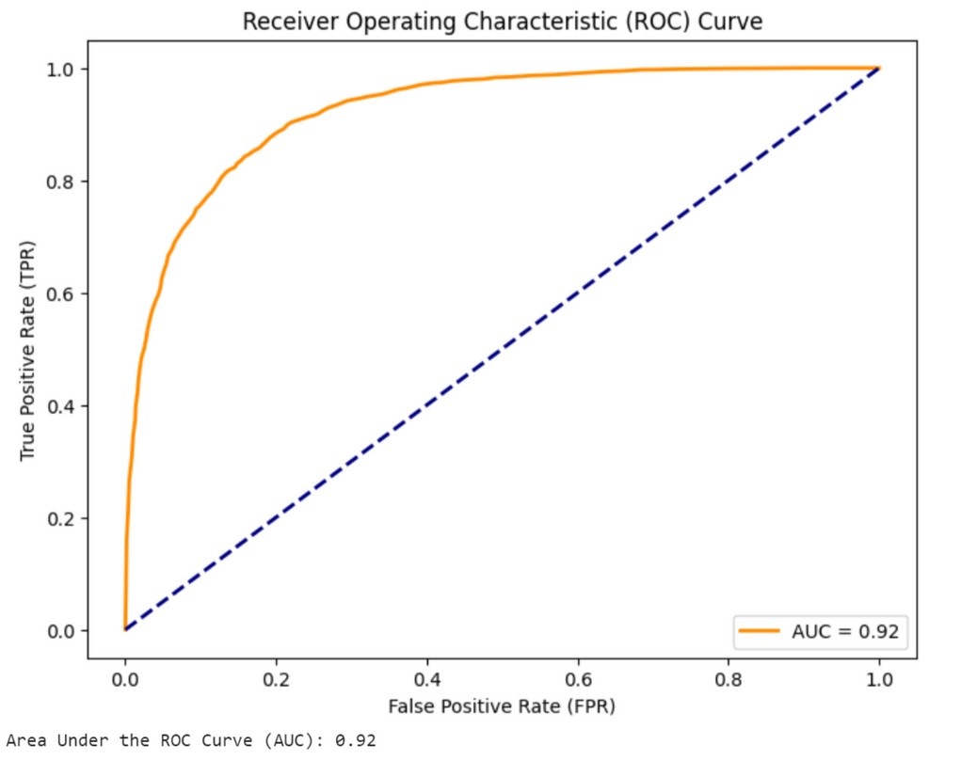
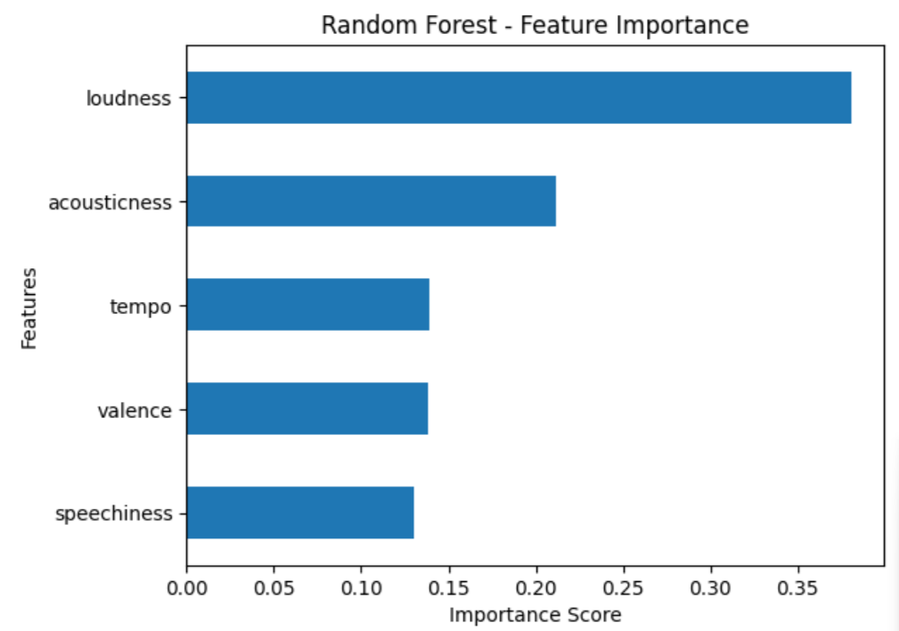
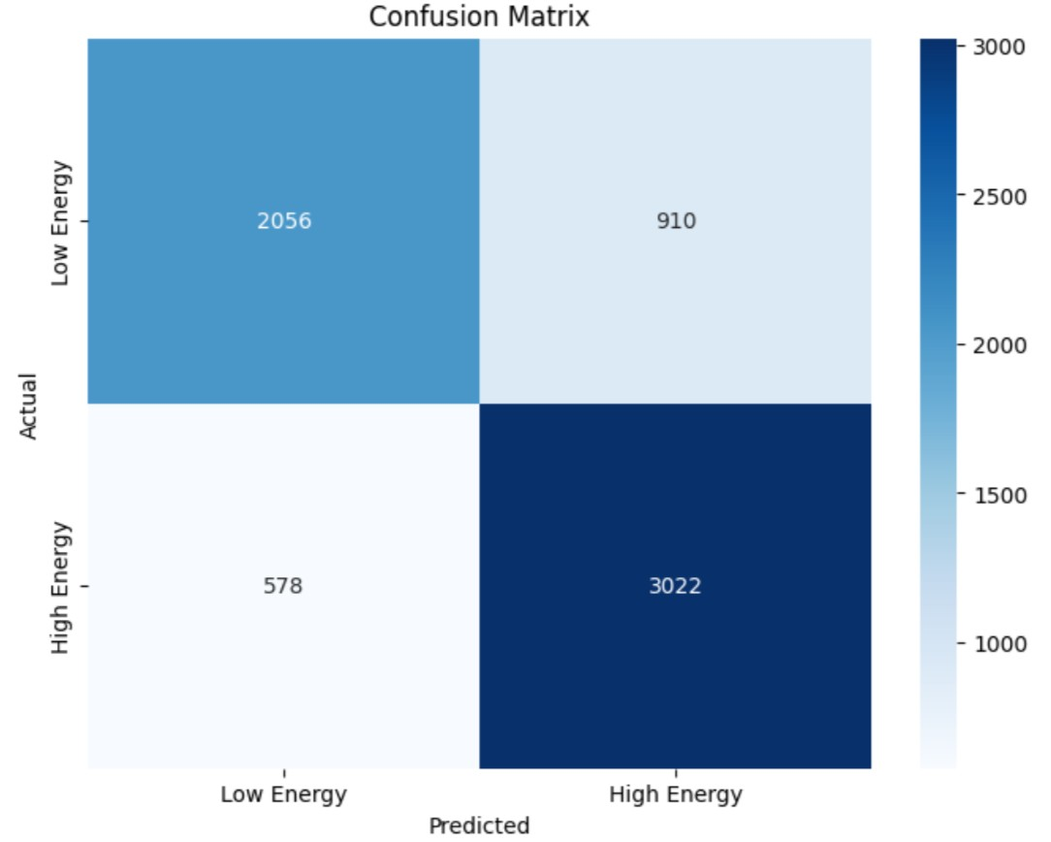
RANDOM FOREST
Notes:
The ROC curve (Receiver Operating Characteristic curve) is a graphical representation used to evaluate the performance of a binary classification model. It illustrates the trade-off between the True Positive Rate (TPR) and the False Positive Rate (FPR) across different decision thresholds.

Slide 19
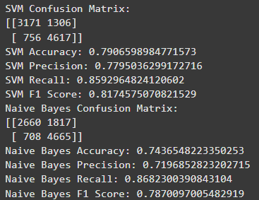
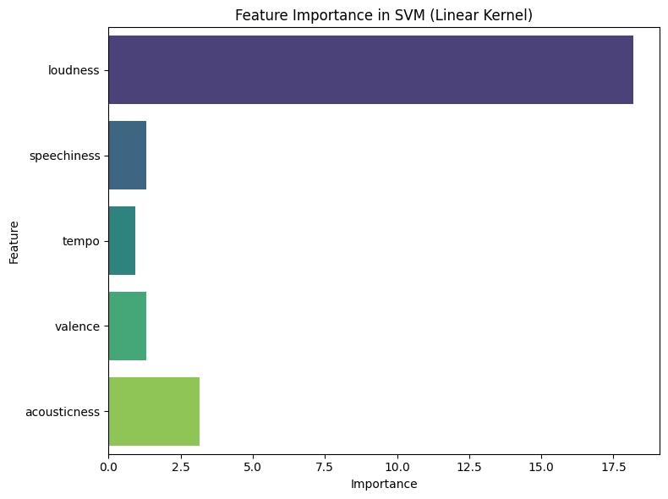
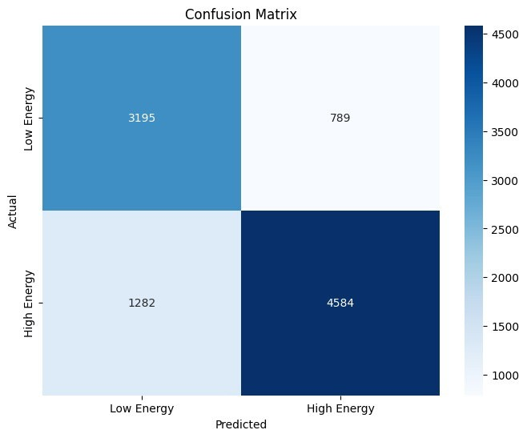
SUPPORT VECTOR MACHINE (SVM)

Slide 20
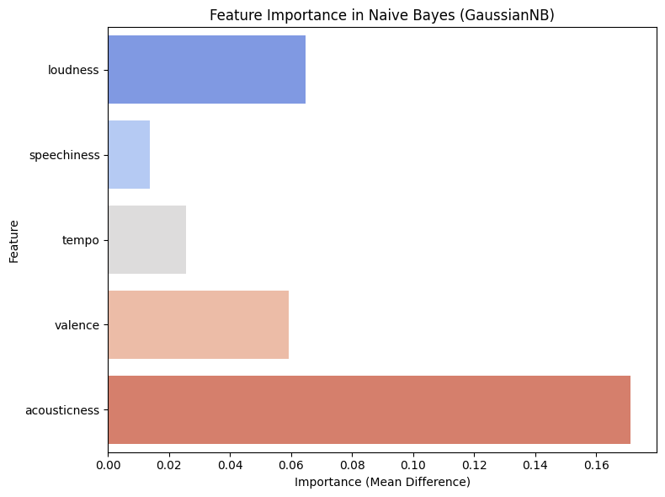
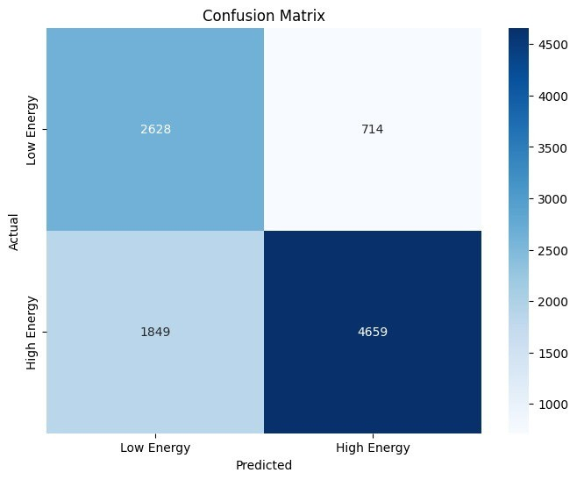
NAIVE BAYES

Slide 21
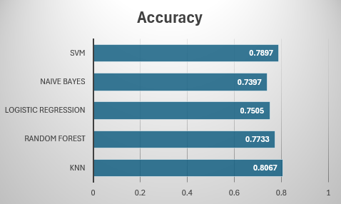
COMPARISION OF ACCURACY
Notes:
From our analysis we can clearly see that KNN performed much better as it focuses on the similarity between closest data points, making it well-suited for datasets where instances with similar features (e.g., tempo, loudness) share the same label (e.g., energetic or non-energetic). Features like loudness and tempo are likely to have clear separations between energetic and non-energetic songs, enabling KNN to classify effectively.
Normalization is crucial for KNN thus Min-Max scaling ensured that all features contributed equally to the distance metric, preventing large-scale features (e.g., tempo) from dominating small-scale ones (e.g., speechiness).
It uses proximity-based voting, making it effective for datasets with clear relationships between features and target labels.
In summary, our project bridges the gap between the technical attributes of music and the emotional connection listeners experience. By classifying songs based on their 'vibes,' we’ve opened up new possibilities for personalized music discovery.
Looking ahead, the integration of user feedback and real-time mood detection could make this system even more adaptive and personalized.

Slide 22
THANK YOU
Notes:
CNNs and DNNs are most effective when working with raw, high-dimensional data like images, audio waveforms, or spectrograms. Since you’re not using raw audio data, simpler models like KNN or Logistic Regression are sufficient for classification tasks.

